Slide 1

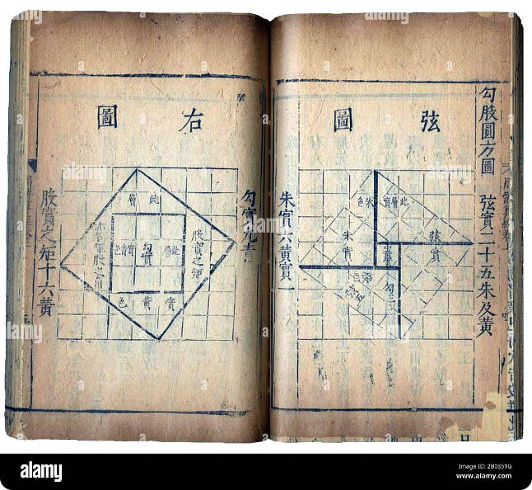

The Chinese Remainder Theorem
The Chinese Remainder Theorem (CRT) is a powerful tool in number theory, offering a solution to solving systems of congruences. This theorem has a rich history and has applications in various fields like cryptography and computer science.

Slide 2

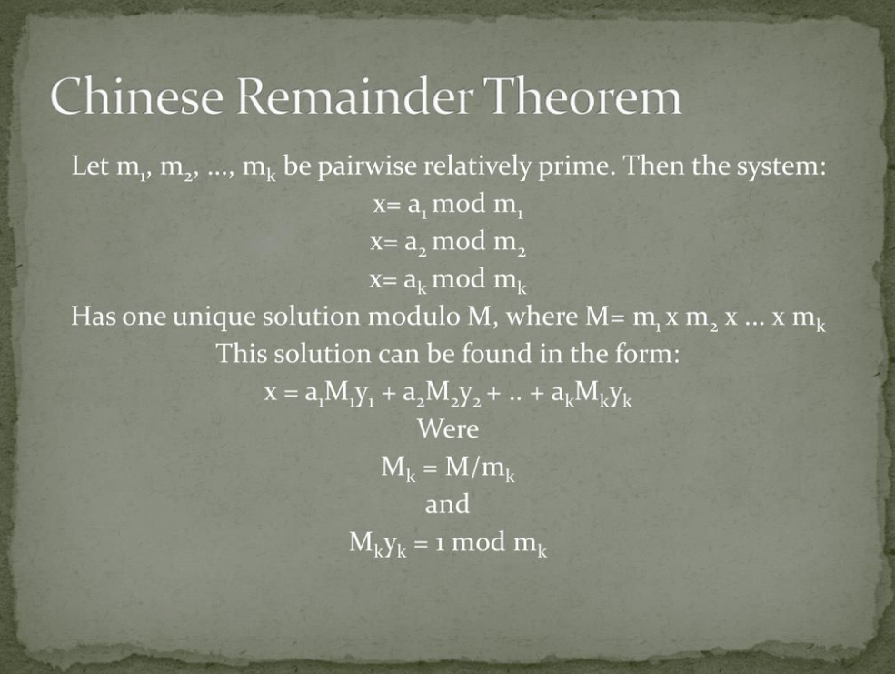
Statement of the Chinese Remainder Theorem
The CRT states that if you have a system of linear congruences where the moduli are pairwise coprime (no common factors other than 1), then there exists a unique solution modulo the product of the moduli.
1
System of Congruences
2
Pairwise Coprime Moduli
A system of congruences involves multiple equations relating integers to remainders.
The moduli in the system should not share any common divisors other than 1.
3
Unique Solution
The CRT guarantees a unique solution modulo the product of the moduli.

Slide 3
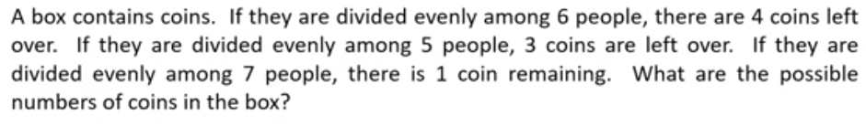
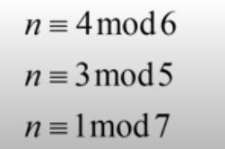
EXAMPLE
a1 | m1 | M1 | M1⁻¹ | M
a2 | m2 | M2 | M2⁻¹
a3 | m3 | M3 | M3 ⁻¹

Slide 4
Solving Systems of Linear Congruences
The CRT provides a systematic approach for solving systems of linear congruences where the moduli are pairwise coprime. This allows for finding a unique solution that satisfies all the congruences simultaneously.
Step 1
Verify that the moduli are pairwise coprime.
Calculate the product of the moduli (M).
Step 2
For each congruence, find the modular inverse of the modulus with respect to m.
Step 3
Step 4
Multiply each remainder by its corresponding modular inverse and sum the results.
The sum obtained in Step 4 represents the solution modulo M.
Step 5

Slide 5
Find X if :
x≡2mod3
x≡2mod4
x≡1mod5

Slide 6
Find X if :
x≡2mod5
x≡7mod7
x≡10mod11

Slide 7
Find X if :
x≡3mod7
x≡3mod5
x≡4mod12

